Slide 1
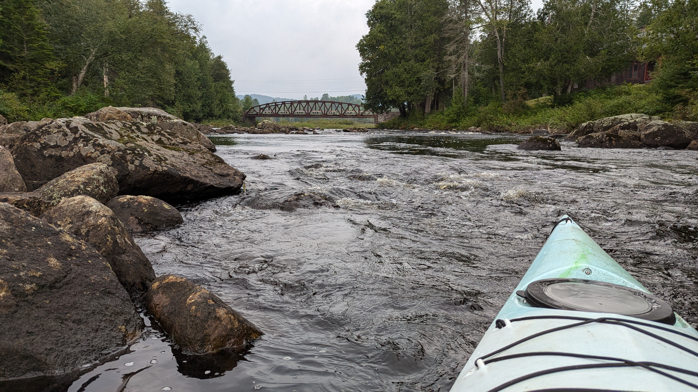

CISC-6100: Software Engineering
Week 1 - September 4
Introduction
Software Development Life Cycle
User Requirements

Slide 2
Outline for today’s class
Presentation slides available on Blackboard for you to follow along with and use for review
Introductions (Who you are)
Who I am
Administrative items
What is software engineering?
Introduction to the Software Development Life Cycle (SDLC)
Motivation
Outline of the semester
Check customer satisfaction (Your feedback)
Requirements gathering and analysis
Homework

Slide 3
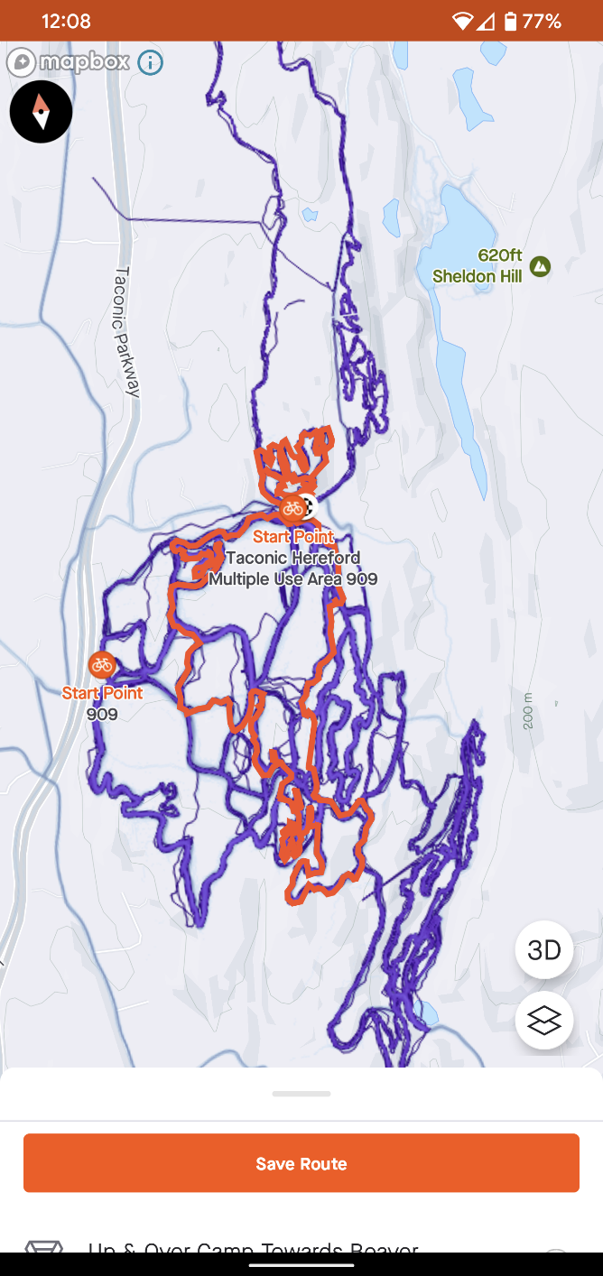
Introductions
Please introduce yourself to me and the class
Name
In a minute or less, describe a favorite app or device without using any technical terms or domain specific terms

Slide 4
Contact Information and Office Hours
Contact Information
Name: Tong Zhou
Email: tzhou44@fordham.edu
Office hours:
Class days: 3:30 – 5:00, 6th floor CS offices (???)
On-demand: just contact me if you want to (virtually) meet 1-on-1

Slide 5
Administrative Items
Week Date
1 September 4
2 September 9
3 September 16
4 September 23
5 September 30
6 October 7
-- October 14 (No school)
7 October 21
8 October 28 -- Midterm
9 November 4
10 November 11
11 November 18
12 November 25
13 December 2
14 December 9 – Teams present project
-- December 14 – Project due
15 December 16 -- Final
Textbook
Software Engineering: A Practitioner’s Approach, 9th edition
Roger Pressman, Bruce Maxim
McGraw Hill, 2020
ISBN 978-1-259-87297-6
Repository for all class materials:
Blackboard
Github

Slide 6
Administrative Items
Class participation: 3%
Engages in participation in breakout drills
Volunteers for answering questions posed in class
Shares perspective of topics being taught
Gives feedback
Grading:
Class participation: 3%
Homework: 12%
Midterm: 20%
Project: 35%
Final: 30%
Homework: 12%
Completeness: 80%
Correctness: 20%
Lateness: 5% off
100 >= A >= 94
94 > A- >= 90
90 > B+ >= 87
87 > B >= 83
83 > B- >= 80
80 > C
Project: 35%
Team contribution: 30%
Individual contribution: 70%

Slide 7
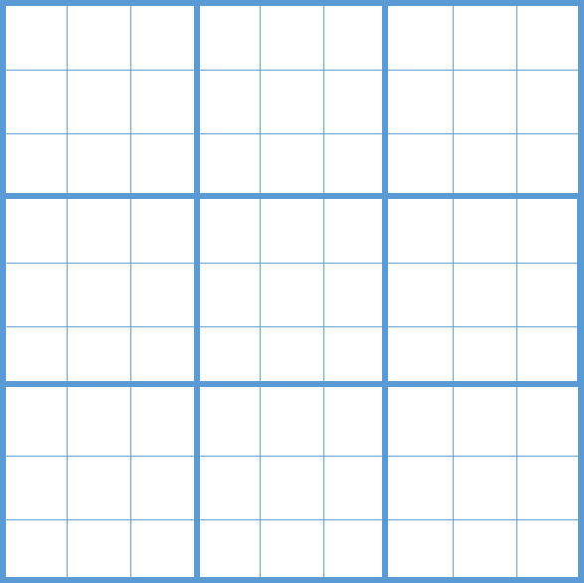
Class project
The class project will design and implement an app for the game of Sudoku.
It will include both individual and team contributions. Teams will be assigned next class.
Most homework assignments will provide input/specifications for the project.
9
6
4
3
Chosen for:
minimal effort required to obtain domain knowledge
readily available examples of this application
5
7
8
2
1
9
5
9
1
8
5
2
4
9
6
4
3
1
7
9
2
6
2
5
9
8

Slide 8
What is software engineering?
Software engineering is the process of:
Analyzing user needs
Designing
Constructing
Testing
end user applications that will satisfy these needs through the use of software programming languages.
It is the application of engineering principles to software development. In contrast to simple programming, software engineering is used for larger and more complex software systems, which are used as critical systems for businesses and organizations.
https://www.techopedia.com/definition/13296/software-engineering

Slide 9
Motivation (continued)
Some notably large codebases include:
Google: monolithic, 1 billion files, 9 million source code files, 2 billion lines of source code, 35 million commits in total, 86 TB total size (January 2015)^{[5]}
Facebook: monolithic, 8 GB (repository 54 GB including history, 2014),^{[6]} hundreds of thousands of files (2014)^{[3]}
Linux kernel: distributed,^{[7]} over 15 million lines of code (as of 2013 and kernel version 3.10)
https://en.wikipedia.org/wiki/Codebase
Team effort!

Slide 10
The Software Development Life Cycle (SDLC)
Requirements gathering and analysis
Design
Implementation or coding
Testing and validation
Deployment
Maintenance

Slide 11
Motivation
Analysis of development costs:
3% analysis
3% specification
5% design,
7% coding!
8% module testing
7% integration testing
67% maintenance
Fundamentals of Software Engineering, 2nd edition
Carlo Ghezzi, Mehdi Jazayeri, Dino Mandrioli
Prentice Hall 2003
~ https://www.researchgate.net/publication/220689590_Fundamentals_of_software_engineering_2_ed
PDF of this source can be downloaded for free.

Slide 12
Outline for the semester
Week Date
1 September 4
2 September 9
3 September 16
4 September 23
5 September 30
6 October 7
-- October 14 (No school)
7 October 21
8 October 28 -- Midterm
9 November 4
10 November 11
11 November 18
12 November 25
13 December 2
14 December 9 – Teams present project
-- December 14 – Project due
15 December 16 -- Final
1-3 weeks on each of the phases of the software development life cycle
Learn about processes to help navigate the development process
Learn about tools that help in specific parts of the development cycle and/or throughout the development process
Work individually, in groups, and as a class on a project to obtain practical experience with the software development life cycle phases, supporting processes, and tools
Mid-term: October 28th
Final: December 16th

Slide 13
Your feedback
From this brief introduction to the course content are their any other topics you were expecting and/or would like to see?

Slide 14
Break time
Class will resume in 10 minutes

Slide 15
Requirements gathering and analysis
Goals:
Understand the critical nature of obtaining and understanding user requirements
Learn various methods to obtain mutually agreed upon user requirements
Understand obtaining user requirements may not be a one-and-done deal
Motivation
The later (new) specifications are made, changes are requested, or errors found, the more timely and costly are the corrections
Software Error Origin in Resulting costs
Requirements 56% 82%
Design 27% 13%
Implementation 7% 1%
Fundamentals of Software Engineering, 2nd edition: Carlo Ghezzi, Mehdi Jazayeri, Dino Mandrioli; Prentice Hall 2003

Slide 16
Requirements gathering and analysis
Class exercise: design a tic-tac-toe game
A game company that markets simple electronic games for children has approached you and your company to design and build a tic-tac-toe game.

Slide 21
“O” Wins!!!

Slide 22
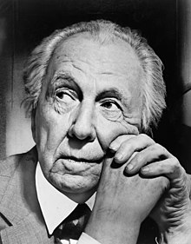


Where do designs come from?
versus
Frank Lloyd Wright
Your team
Customer’s team
https://en.wikipedia.org/wiki/Frank_Lloyd_Wright

Slide 23
Requirements gathering and analysis
Class exercise: design a tic-tac-toe game
A game company that markets simple electronic games for children has approached you and your company to design and build a tic-tac-toe game.
In your breakout group work with your team to identify:
What is/are the next steps with the customer?
What further questions do you have for your customer?
Identify who in your customer’s business you’ll need to work with
Identify the skill sets that someone on your team will need to have
Work for about 10 minutes.
When we rejoin each team will have an opportunity to share their results.

Slide 24
Requirements gathering and analysis
Class exercise: design a tic-tac-toe game
Group 1:
Vanessa
Jan M. B.
Jan C. B.
Mark
Jason
Group 2:
Danny
Mintesnot
Michael
Anthony
A game company that markets simple electronic games for children has approached you and your company to design and build a tic-tac-toe game.
In your breakout group work with your team to identify:
What is/are the next steps with the customer?
What further questions do you have for your customer?
Identify who in your customer’s business you’ll need to work with
Identify the skill sets that someone on your team will need to have
Work for about 10 minutes, then take a 5 minute break.
When we rejoin in 15 minutes each team will have an opportunity to share their results.
Group 3:
Moyo
Robert
Prarthana
Gurpreet
Sichen
Group 4:
Juliette
Aryan
Kumar
Jonathan
Venika

Slide 25
Requirements gathering and analysis
Class exercise: design a tic-tac-toe game
what are the rules
how do you want the user to experience the game
timeline
budget
audience
platform
are users in the same room
What are the next steps for working with your customer? What might be some further questions?
Features
Deadline
Difficulty levels
Fun factor
Age group
Translations
Contract
Costs
Deployment
From scratch/ or known engine
Language
Demographic
Multi-player or against the computer
Micro transactions

Slide 26
Requirements gathering and analysis
Discussion
Who to interview
client (the person who is paying)
Decision maker (C*O)
Domain expert
User
IT staff
Legal
HR
When to interview/update/validate
Who in your customer’s business will you need to work with?
Marketing
Translators
Designers/artist

Slide 27
Requirements gathering and analysis
Discussion
Who should conduct the interview(s)
IT department representative
Data analytics expert
Human experience designers
Lead programmer
Systems architect
Project leader
Legal department
What are the skill sets your team will require?
Technical writer
Graphics designer
Programmer
Developer
Product manager
Tester
Children’s expert

Slide 28
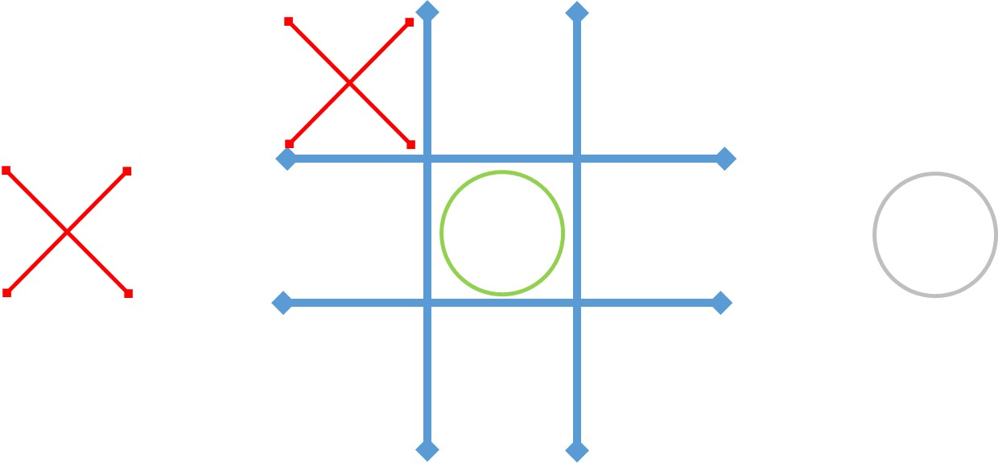
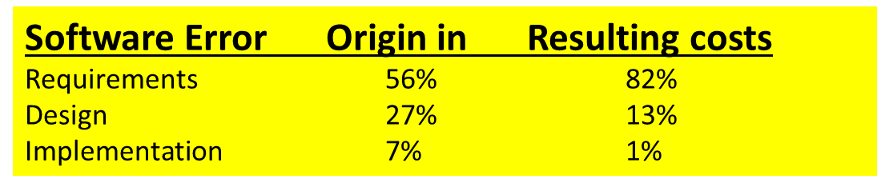

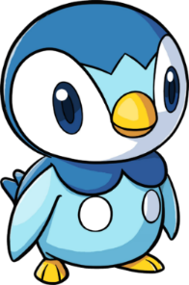

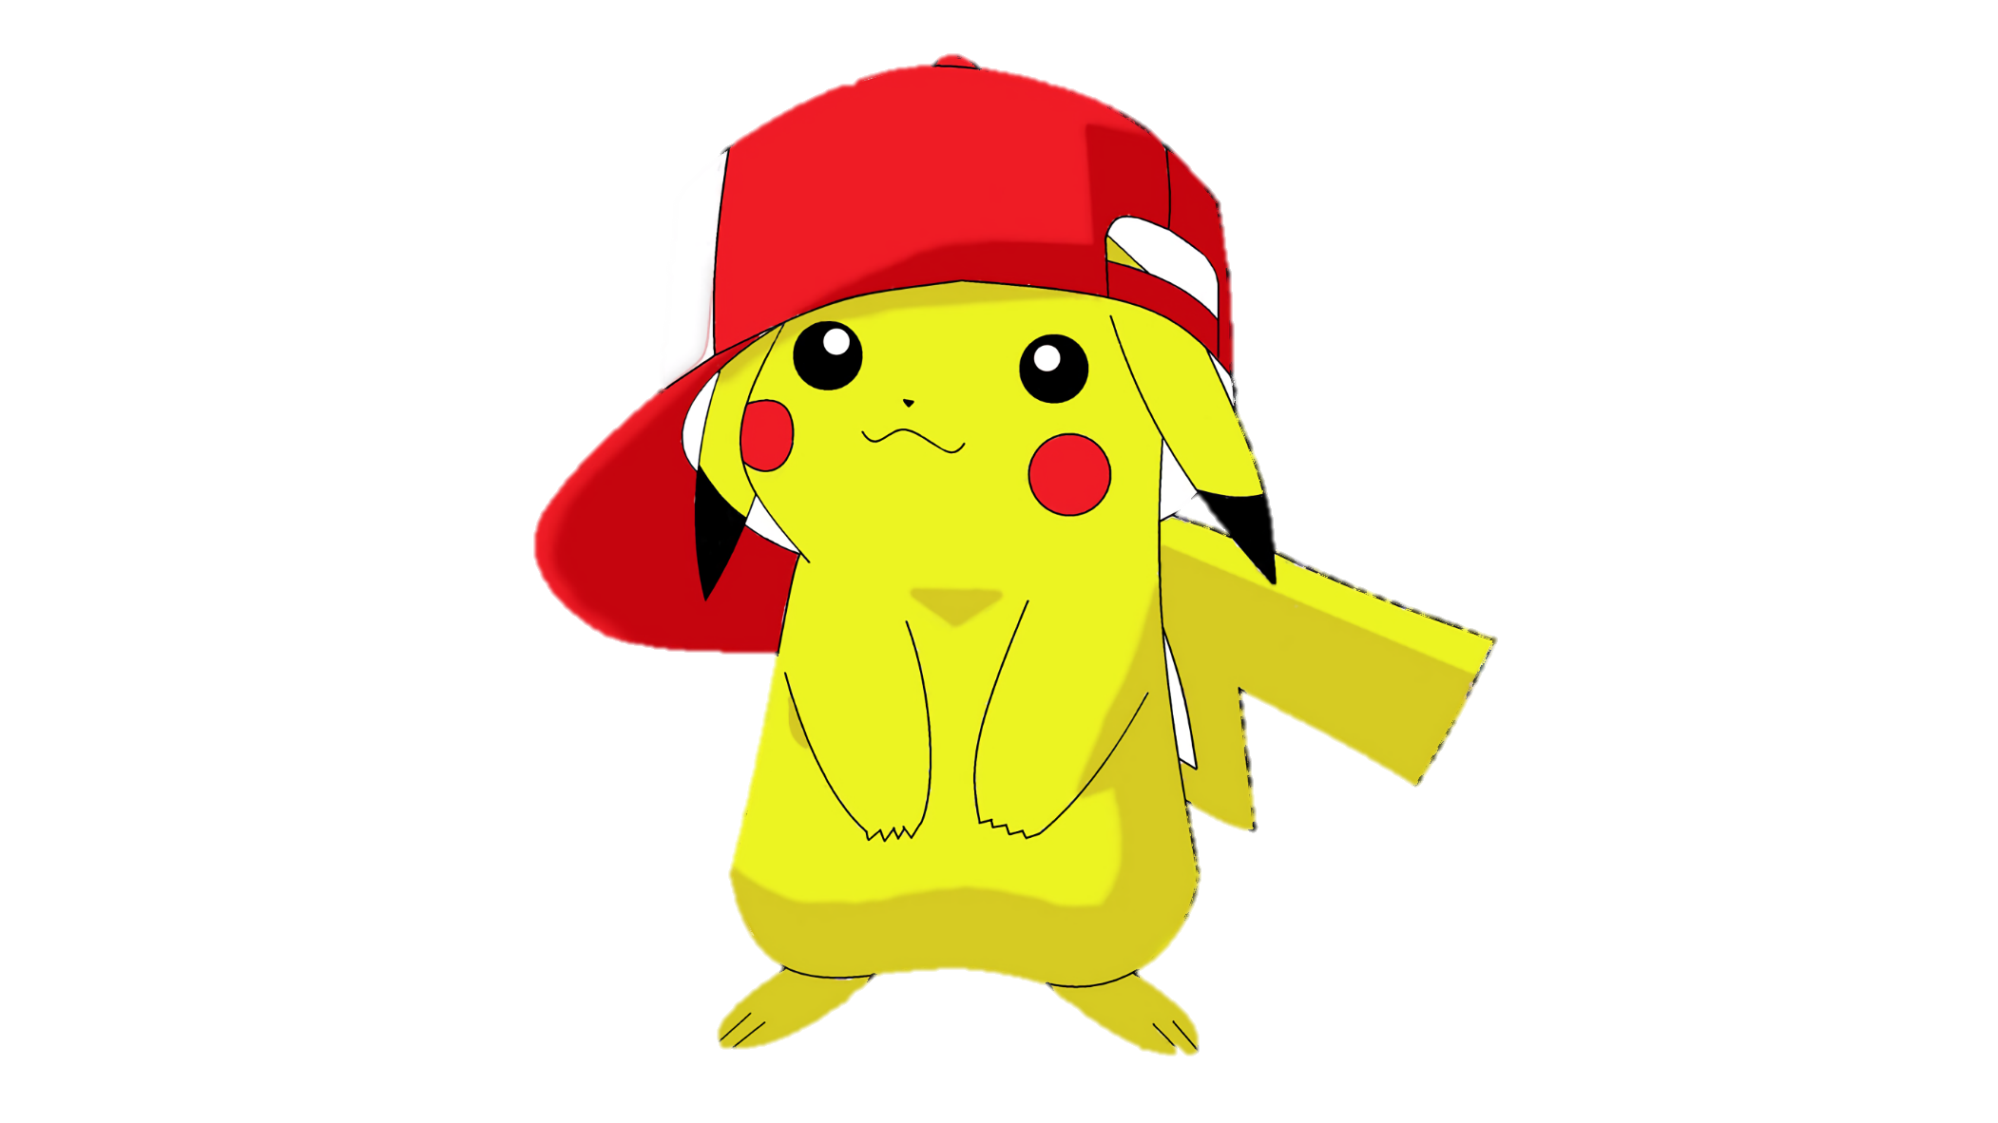


Slide 29

UNDO

Slide 30
Requirements gathering and analysis
Goal: Fully documented requirement specifications
Not all requirements are known (or at least articulated) ahead of time
Mismatch in knowledge bases
Methods: Story boarding / Rapid prototyping
Paper / pencil
Interactive white board sessions
PowerPoint
UI builder in the SDK you plan on using (e.g., Visual Studio)
Web page designers

Slide 31
Example storyboards from a previous semester
Create storyboard(s) for a chess application that will:
Show the customer your understanding of their vision
Look and feel
Features
Act as a starting point for the technical design of the application
Critique the following efforts against the requirements above.

Slide 32



Chess
Friends interact using laptop camera
Notes:
Royalty images from https://www.pexels.com

Slide 33
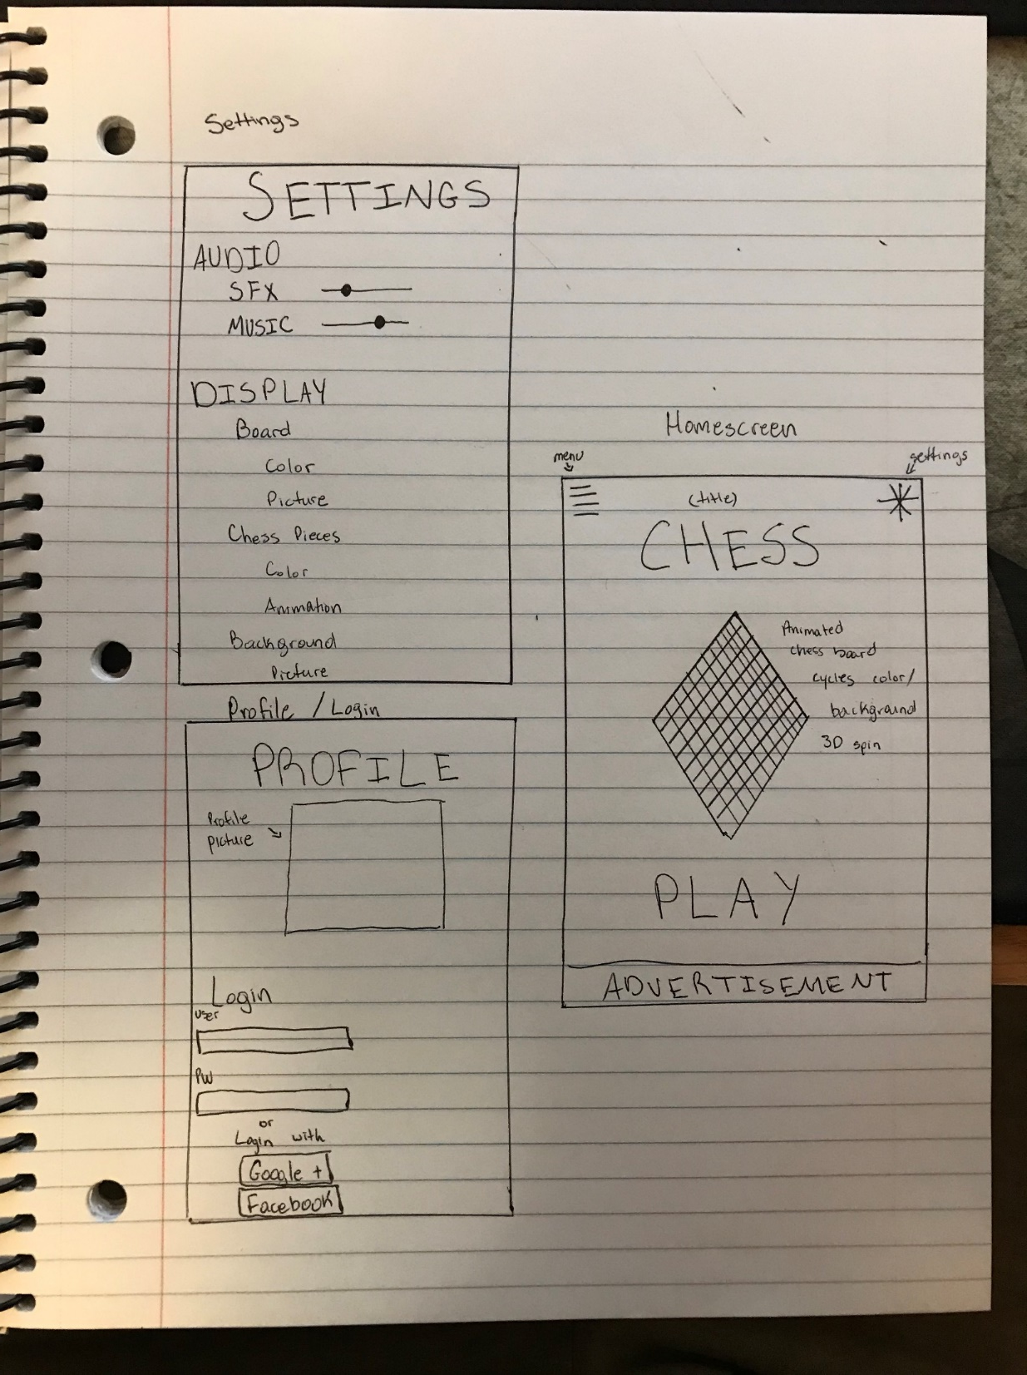

Slide 34
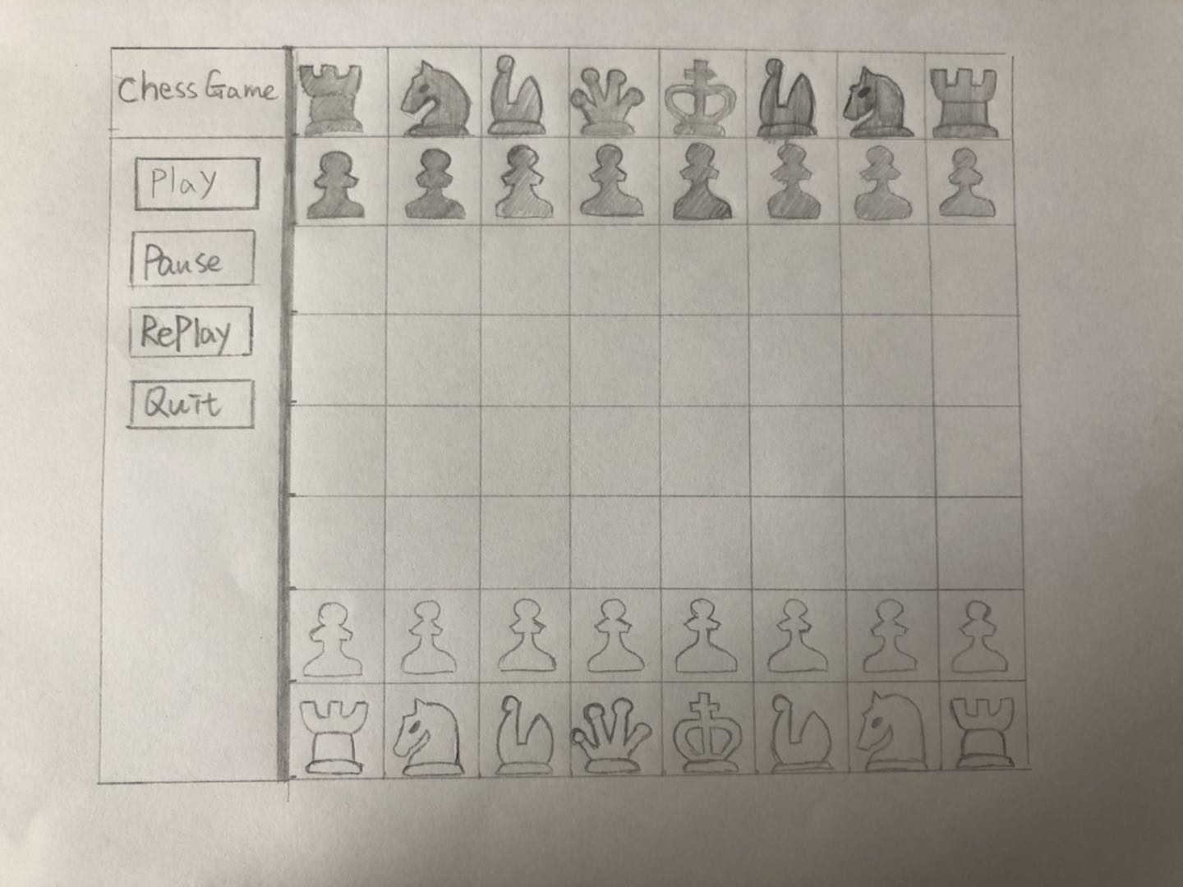

Slide 35
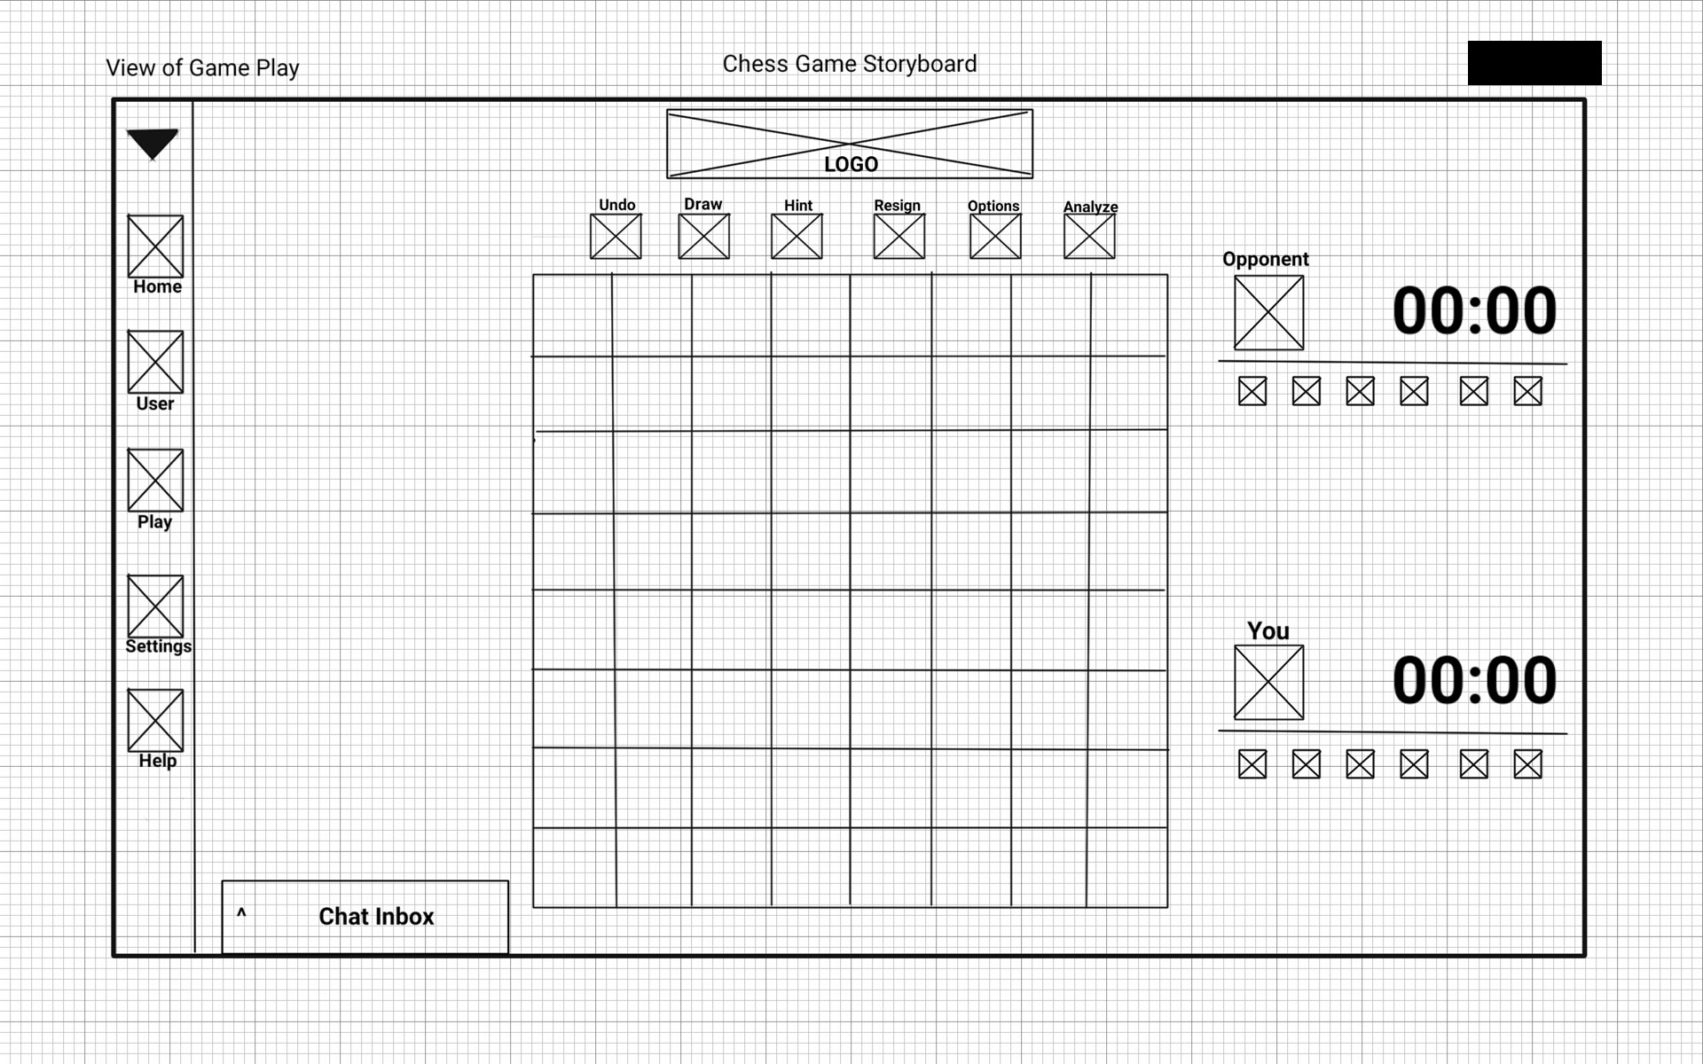

Slide 36
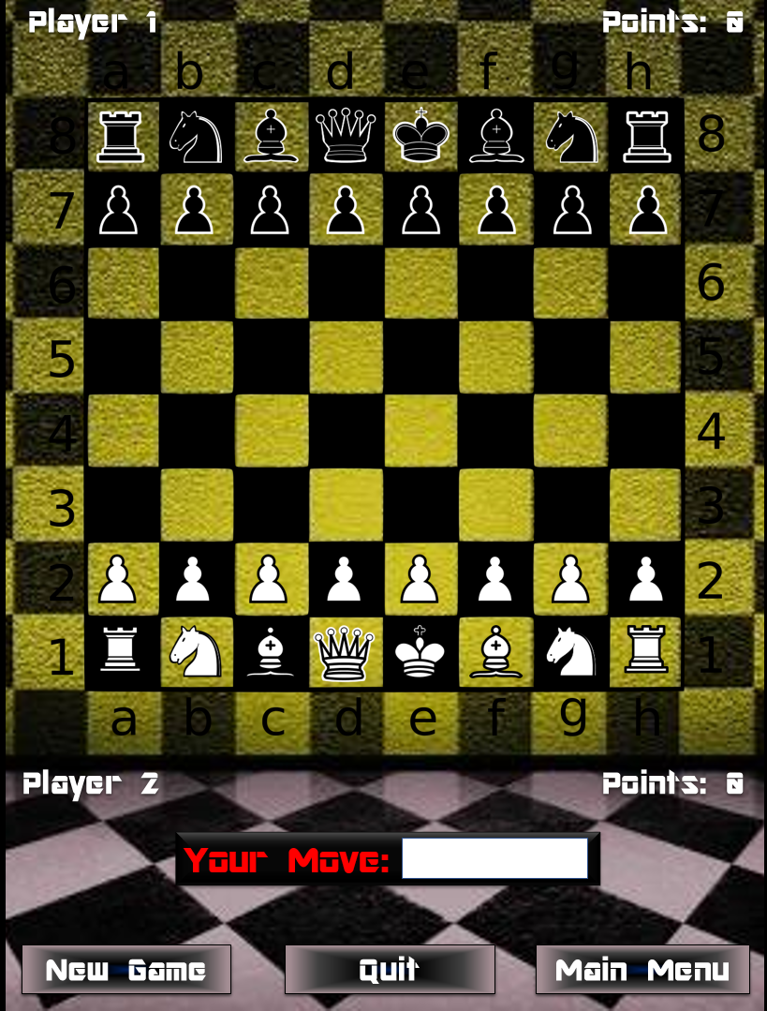

Slide 37
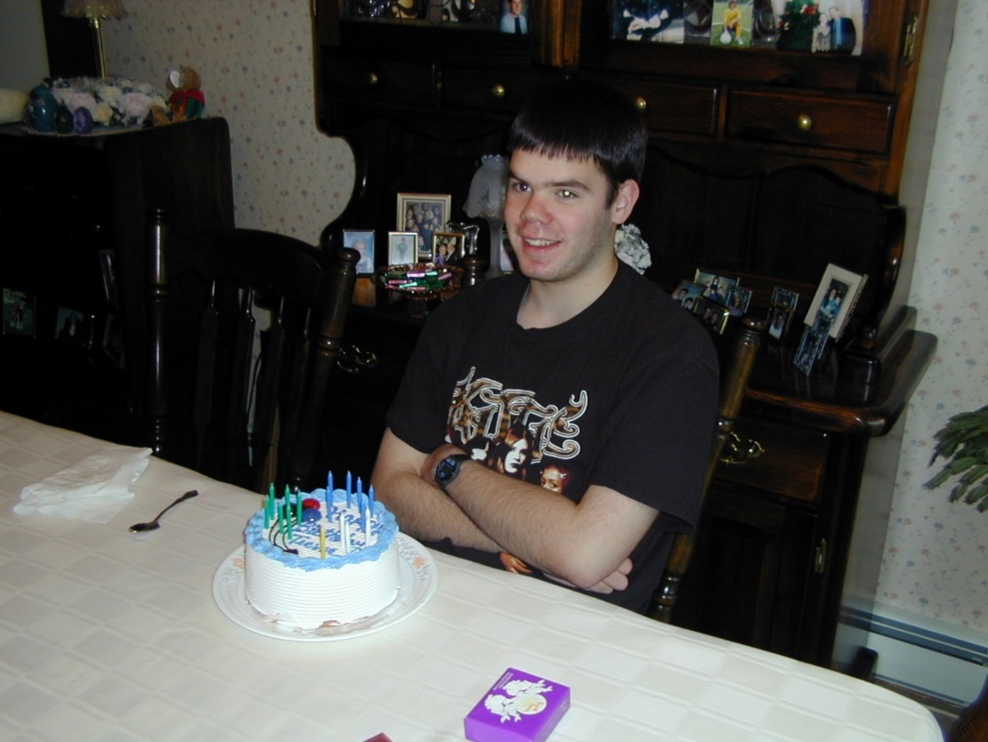
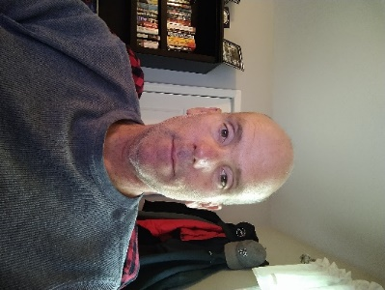















Game Type
Find Opponent
Profile
View
Help
30:00
30:00

Slide 38
Game Type
Find Opponent
Profile
View
Help
24:30
22:14

Slide 39
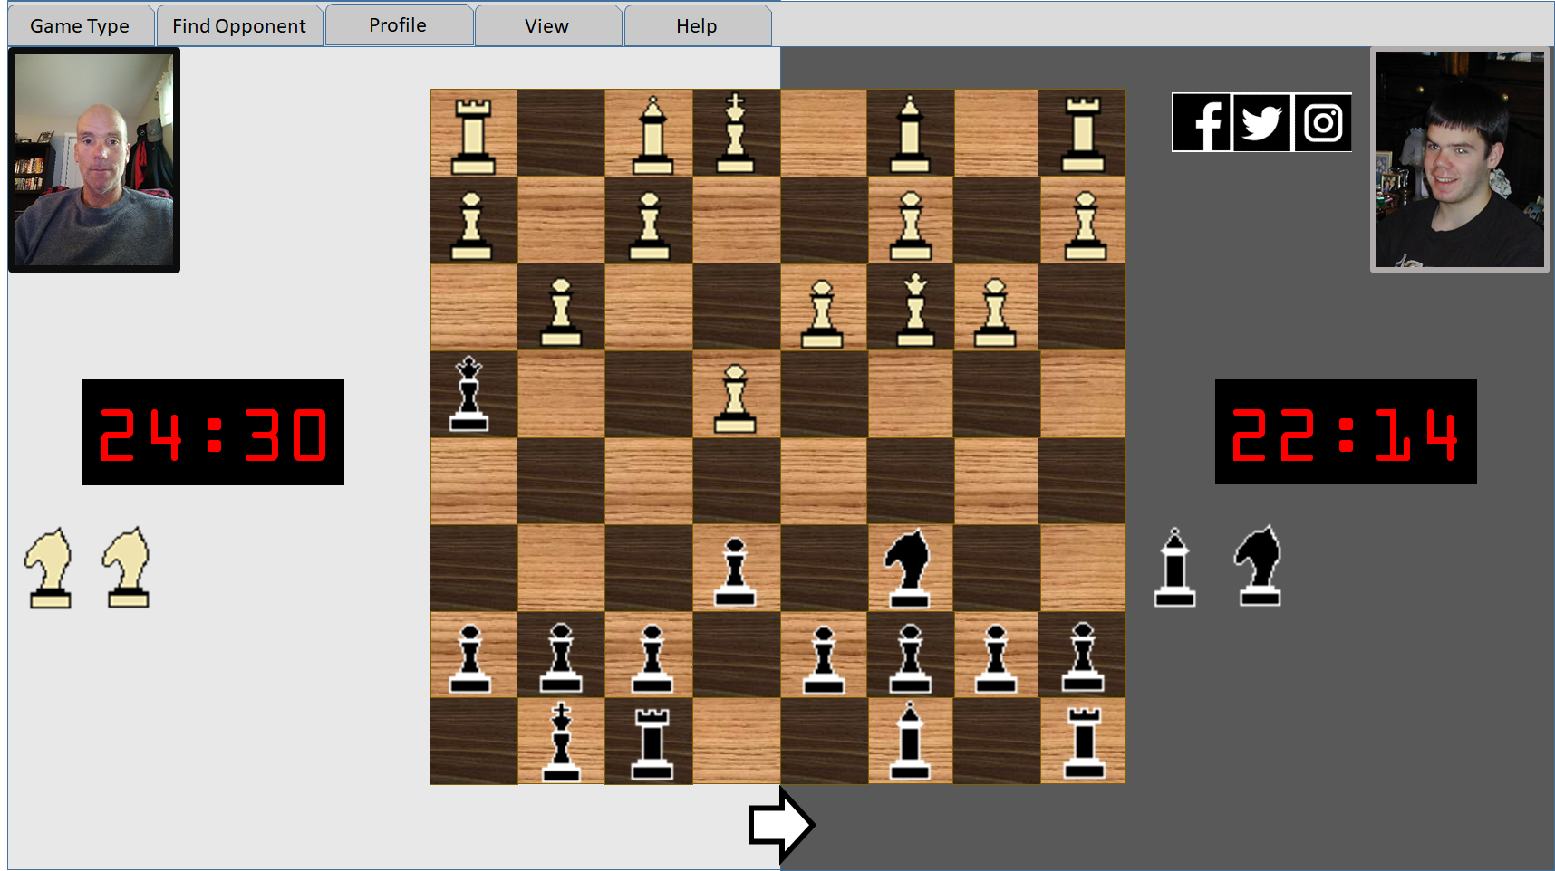
Game Type
Find Opponent
Profile
View
Help
24:30
22:14

Slide 40
Game Type
Find Opponent
Profile
View
Help
Regular
Speed Chess
Learning Mode
Local
Network friend…
Network random
Same rank
Higher rank
Lesser rank
Computer
Same rank
Higher rank
Lesser rank
Edit…
Audio link off
Video link off
Rules…
About…
30:00
30:00

Slide 41
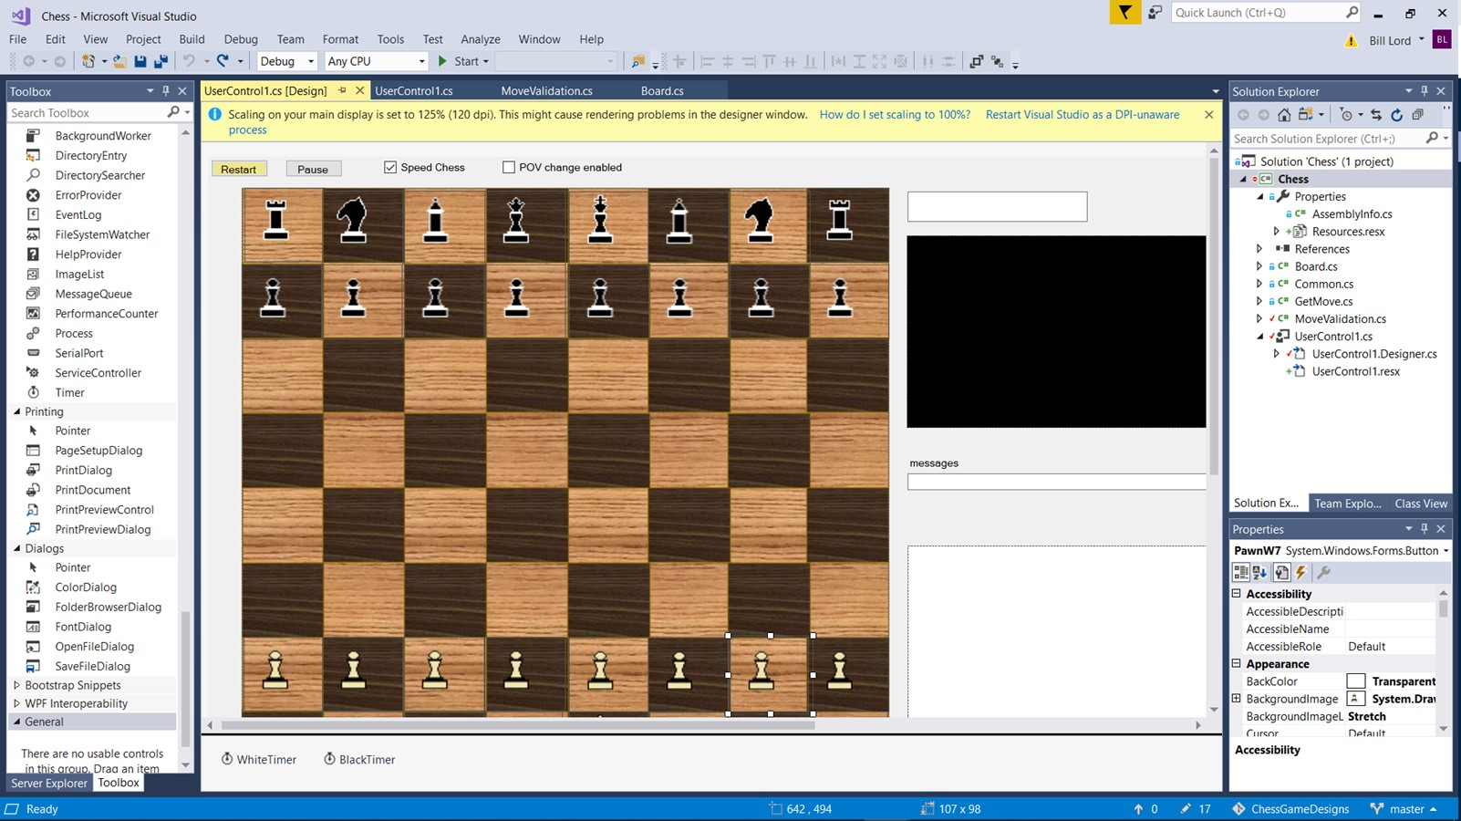
As before but created in a GUI designer / SDK

Slide 42
Requirements gathering and analysis
Real-life examples
Come up with a solution to long waiting times in the Emergency Department
Increasing patient satisfaction
Provide a navigation system for handling rarely seen conditions
End users are barely computer literate
End users use the system once every three months (among many others)

Slide 45
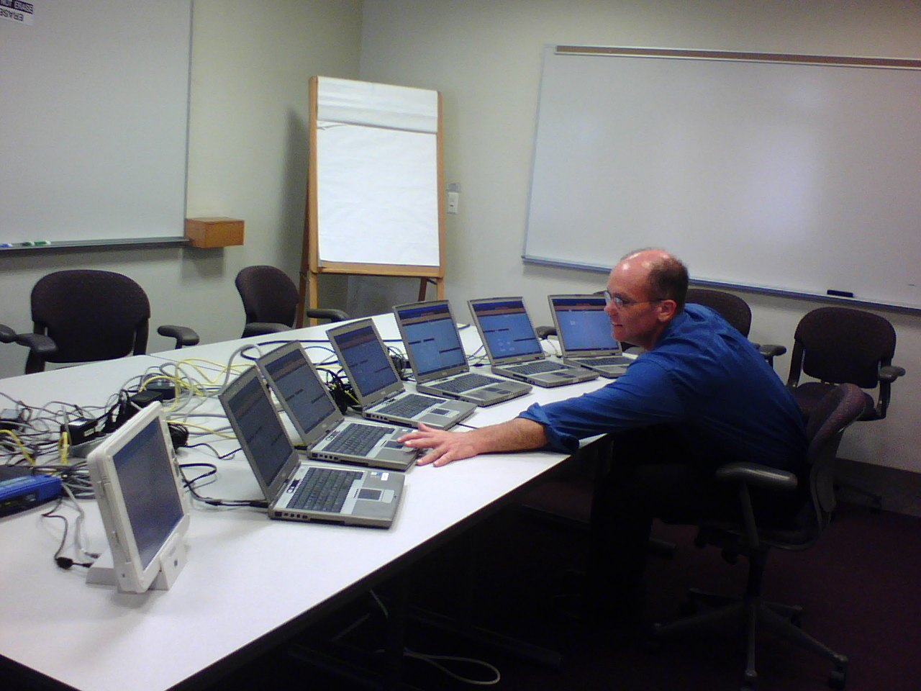

Slide 46
Homework
Please complete by September 8th, 6:00pm
Which of these programming language have you programmed in?
JavaScript
HTML / CSS
Python
Other? (please list)
Do you have a server (or access to a server) on which to set up a server-side application?
Have you done database programming / administration?

Slide 47
Homework and AI
Create an initial storyboard for the Sudoku Puzzle Playing/Developing application based on the following two slides
3 or more key views
For this, and some/most other homework assignments, I will ask you to try two approaches:
Attempt homework on your own
Attempt using the help of an AI (e.g. the free version of ChatGPT, Google, …)
For these homework assignments please supply one paragraph on why:
The AI did not help
The AI helped some
The AI could complete the whole assignment
All homework should be submitted before 6:00pm on the day before the next class.

Slide 48
Homework
Obtain our textbook - Software Engineering: A Practitioner's Approach
Look through (skim) Chapter 6 (We will revisit many of the principles presented throughout the semester)
Read Chapter 7 through section 7.4 inclusive
Read ACM article on use of AI in learning:
https://cacm.acm.org/news/the-impact-of-ai-on-computer-science-education/

Slide 49
Sudoku Puzzle Playing/Designing App
Example of a 9x9 puzzle
9
6
4
3
2
9
6
1
4
5
8
3
7
5
7
8
2
3
5
7
8
2
6
1
4
9
1
9
5
1
4
8
9
3
7
5
2
6
9
1
8
6
3
9
5
1
2
4
7
8
5
2
5
8
1
7
6
4
3
9
2
4
9
6
4
7
2
3
9
8
6
1
5
4
3
1
9
6
4
2
8
3
7
5
1
7
9
2
6
8
1
5
4
7
9
2
6
3
2
5
9
8
7
2
3
6
5
1
9
8
4

Slide 50
Sudoku Puzzle Playing/Designing App
Create a system that facilitates the following:
An app for users to solve Sudoku puzzles on. Features of which will include:
2-dimensional puzzles of various sizes (4x4, 9x9, 16x16)
Puzzles can be selected from a library or generated on demand
Selectable difficulty levels
Area to make notations
Check solution as far as completed
Undo last move
Undo until all mistakes gone
Get a random or specific hint
Timing solution
An app for users to create Sudoku puzzles on. Features of which will include:
Creating grids of various sizes
Populate initial entries manually or have generated
Use / define alternative representation to numeric entries
Most professional projects require one or more team members to have significant domain knowledge. Our project has been chosen to help minimize that requirement.

